Slide 1

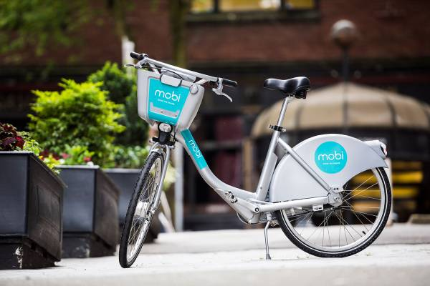
Bike Stations and businesses Statistical Modelling project Melissa Nielsen November 7, 2022

Slide 2
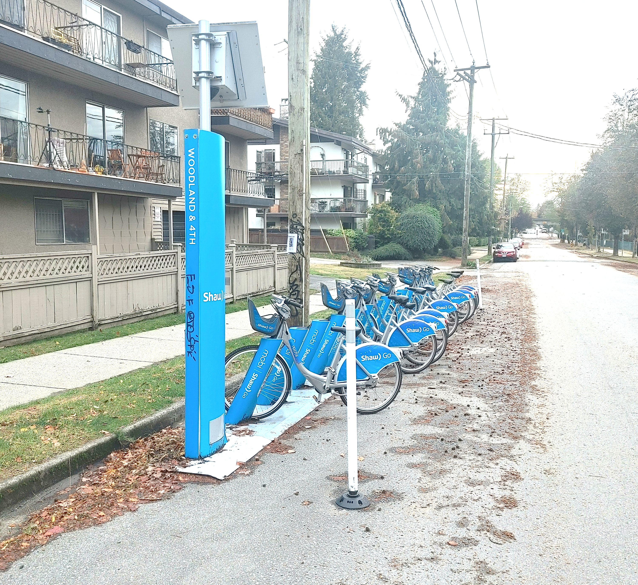
Project Overview
Get data from CityBikes API
Get data from Foursquare and Yelp APIs
Join data and create database
Create regression model

Slide 3
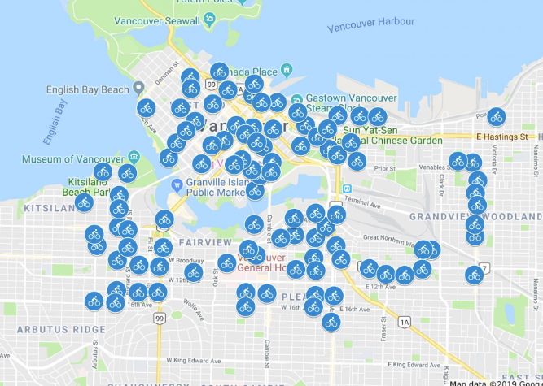
Project Scope
Looked at Mobi bikes in Vancouver, BC
Investigated following business types within 100 m of every bike station:
Bars
Restaurants
Shopping
Education
Arts and Entertainment
Looked at total numbers of open and closed businesses

Slide 4
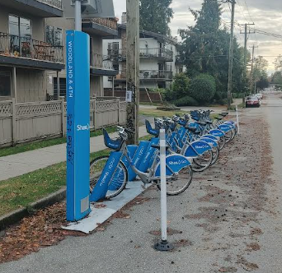
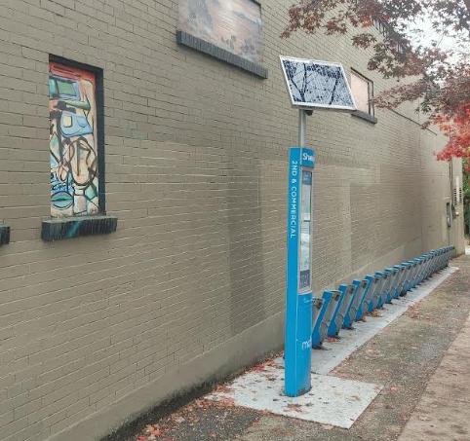
Key Question
Is the number of open businesses correlated with the proportion of available bikes?

Slide 5
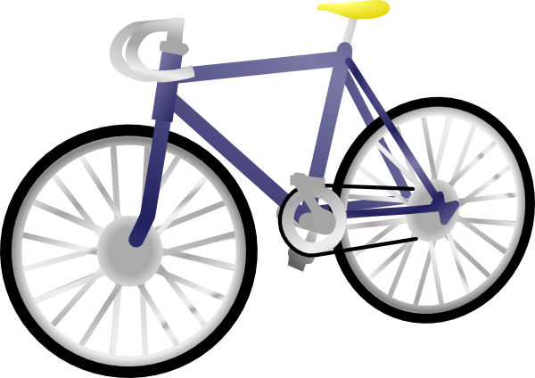
SteP 1: City Bike API
Parsed JSON file
Removed stations with status “offline”
There were 240 online bike stations in Vancouver

Slide 6
Step 2: Get Data from Foursquare and Yelp APIs
Used requests.get() function
For each of the Yelp and Foursquare APIs, created a loop to do the following:
For each lat/long coordinate:
Look at each of the five chosen business types
Count all businesses
Count open businesses
Append results to list
Reshape list into dataframe and merge dataframe with station ids

Slide 7
Step 2: Compare Results from foursquare and yelp
Foursquare had more overall restaurants, so used foursquare data for further analysis

Slide 8
Step 3: joining and Exploring data
Combined Foursquare and Citybike data using pd.merge and a left join
Joined on the key “Station ID”

Slide 9
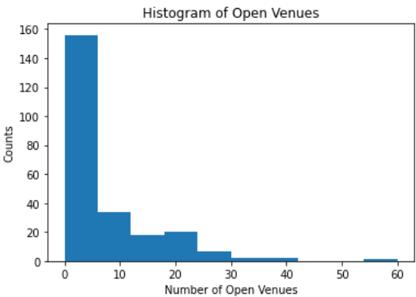
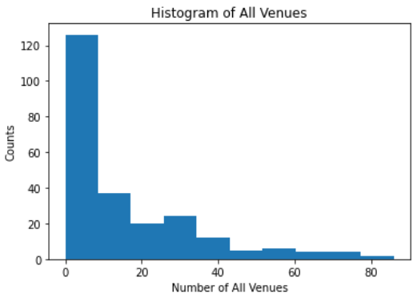
Step 3: joining and Exploring data
Explored data using:
histograms
Data not normally distributed

Slide 10
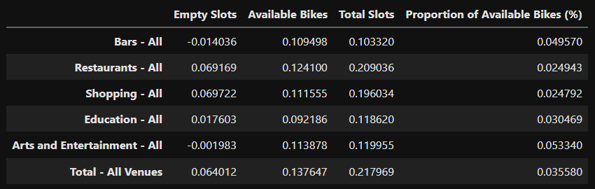
Step 3: joining and Exploring data
Explored data using:
correlation coefficients
Low correlation coefficients!

Slide 11
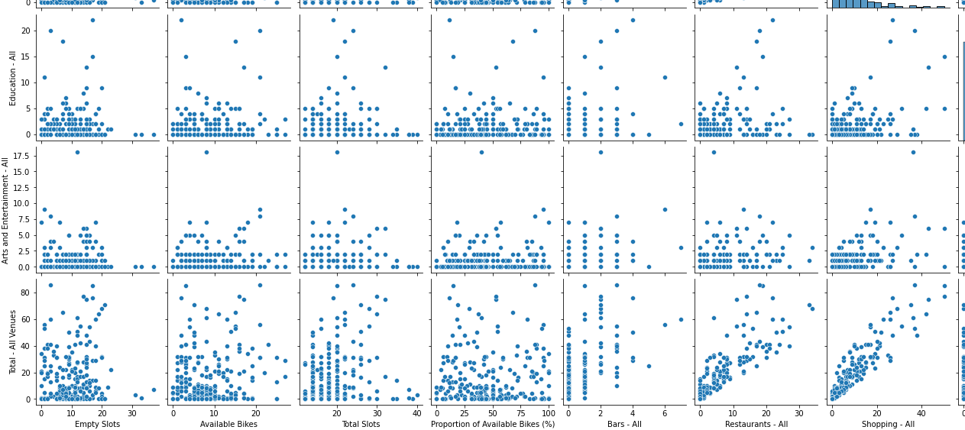
Step 3: joining and Exploring data
Explored data using:
scatter plots
Relationships between bikes and businesses not linear

Slide 12
Initial Findings from EDA:
No correlation between quantity of open businesses and proportion of available bikes
Low correlation between total slots and number of total businesses
Low correlation between total slots and number of restaurants

Slide 13
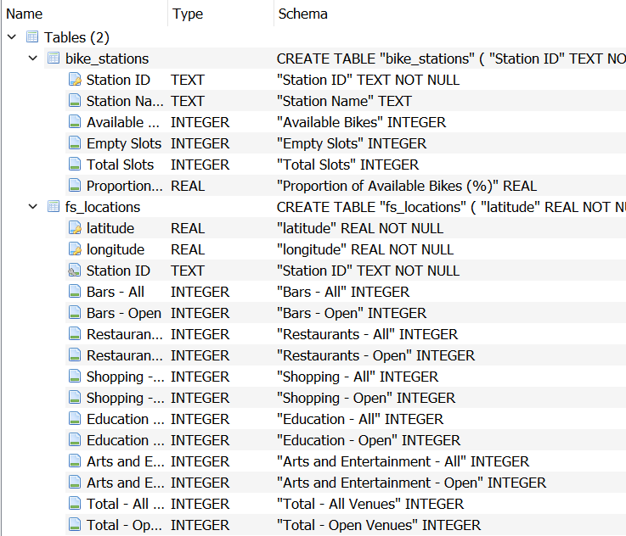
Step 3: Create SQLite Database
Bike Stations Table:
Used “Station ID” as primary key
Foursquare Locations Table:
Used “latitude” and “longitude” (combined) as primary key
Used “Station ID” as foreign key
one-to-one relationship

Slide 14
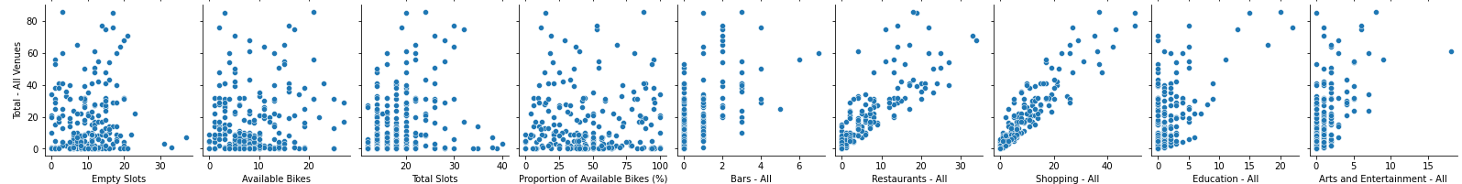
Step 4: Create Model
No linearity found between bikes and businesses
Linearity found between:
Number of restaurants and total number of businesses
Number of bars and total number of businesses

Slide 15

Step 4: Create Model
How many bars in an area based on number of other business types?
Dependent variable is number of bars (y)
Independent variables (x₁, x₂, x₃, x₄, x₅):
number of restaurants
number of stores
number of arts and entertainment businesses
number of education businesses

Slide 16
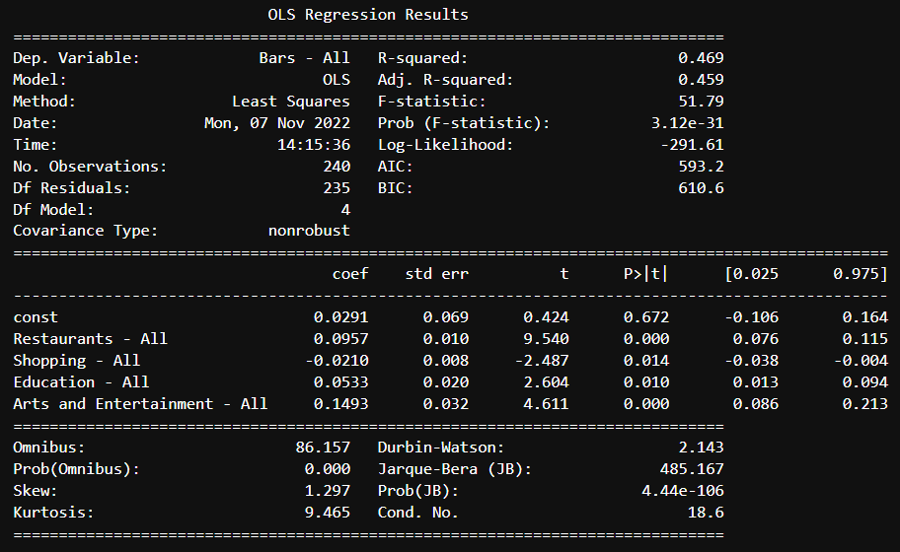
Step 4: Create Model
Model results:
R-squared: 0.469
R-squared: 0.45
…not a great model
p-values: under 0.05 so kept all independent variables

Slide 17
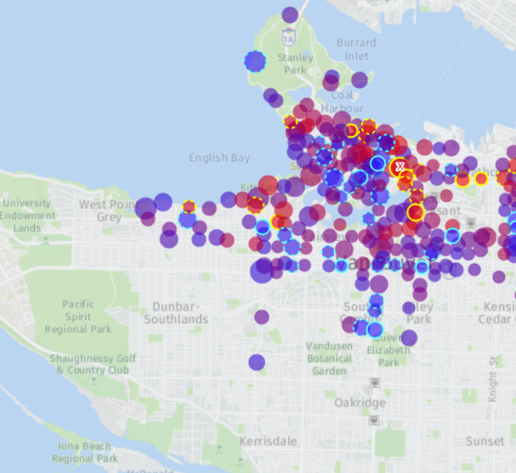
IF I HAD MORE TIME
See how open-ness affects availability of bikes by looking at bike availability at different times
Would look at density of total bikes, not just bikes per station

